Slide 1

Digging into the DEA Opiate Database
Project 1
Wyatt Carnes, Keven McClard, John Solts
July 30th, 2019

Slide 2
Hypothesis

Slide 3
Data Sources
DEA database published by the Washington Post
https://www.washingtonpost.com/graphics/2019/investigations/dea-pain-pill-database/?utm_term=.8654ced443f9
“Data analyzed includes only shipments from sales of oxycodone and hydrocodone pills to retail pharmacies, chain pharmacies and practitioners. The entire database tracks a dozen different opioids, including oxycodone and hydrocodone, which make up three-quarters of the total pill shipments to pharmacies.”
80GB of raw data including:
Manufacturer
Distributor
Type of Pill
Quantity of Pills
Dosage
United States Census API Data
https://www.census.gov/developers/
County level:
Population
Median Income
Occupations
Poverty Rates

Slide 4
Parsing and Cleaning Data

Slide 5
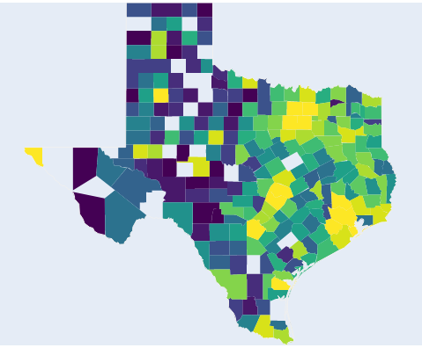
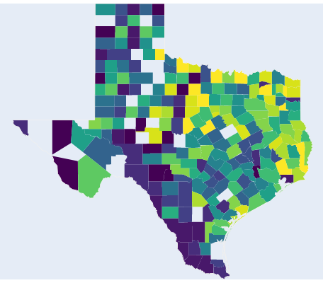
Analysis
Total Opiate Dosage Ordered
Per Capita Opiate Dosage Ordered

Slide 6
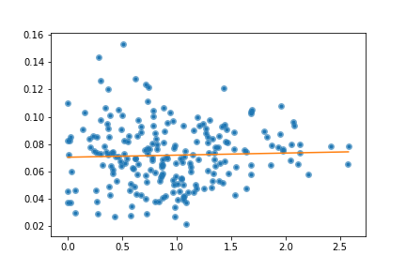
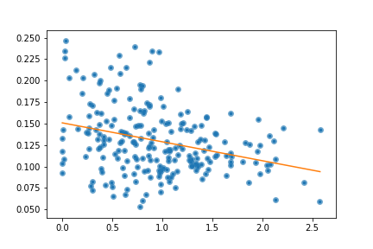
Analysis
Poverty Rate vs Pill Quantity
Construction Jobs vs. Pill Quantity

Slide 7
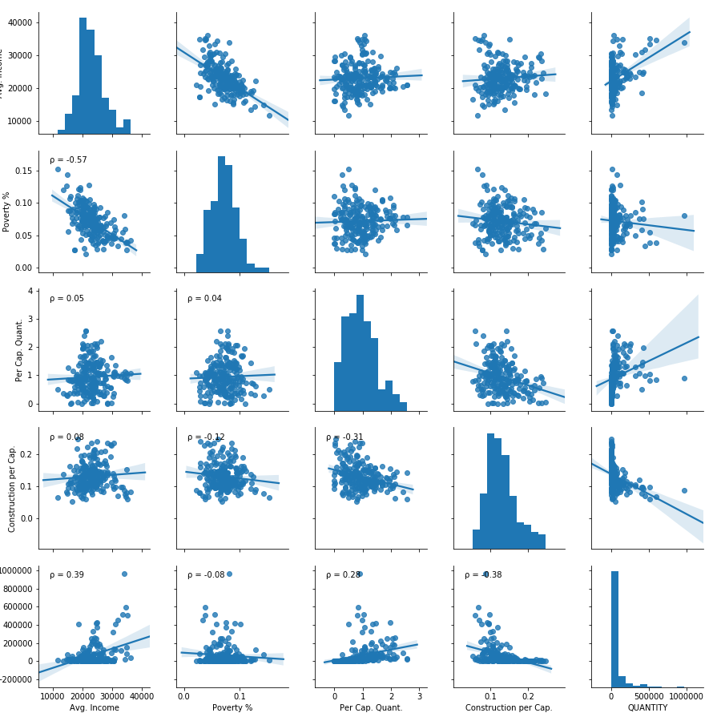
Analysis

Slide 8
Challenges
80GB DEA database was too large to handle normally and had to be broken down into multiple smaller files and then parsed into state level files to be useable in Pandas
The DEA database had very poor documentation

Slide 9
Conclusions and Further Work

